Slide 1

How Safe is Our School?
School Safety and Climate
Notes:
Many of your staff may believe in a narrow definition of safety that revolves around violent threats like shootings or bomb treats. This approach ignores other less dramatic violence that can be happening daily in schools. Bullying, harassment, insults, or unequal distribution of resources are just some of the things that students report lead unsafe conditions. How folks in your school feel on a daily basis, how others behave and how the administration has the school organized at some of the things that go into making a school’s climate protective or toxic.
To start building a base for school wide understanding of how important is for feelings of safety, the power point makes the argument for a spectrum of prevention interventions based on the situation at hand. The next slide outlines those conditions for Prevention, Intervention, and Response. This presentation focuses on building and maintaining a positive climate and building the infrastructure to support the climate. Throughout the presentation, there are optional reflections/discussion questions to help folks digest the information and think about how it might apply in their situation.
A study of the school shooting around the time of Columbine revealed that in about 80% of the cases, at least one student at the school knew of the shooter’s intentions and did not tell an adult. These students reported that they did not want be a tattle tale nor did they think the administration would do anything about it. How would things have been different if students felt the climate was open enough to have told an adult?
The focus on climate seeks to help build relationships between students, teachers, and administrators such that students would be open to report threatening situations. How would things have been different if there were an advertised process by which students could anonymously reported a threatening situation? How would things have been different if adults had been trained in threat assessment and response?
The next slide will outline the three conditions that require either Prevention, Intervention or Response strategies. The rest of the presentation will focus on the role climate plays in preventing dangerous or escalating situations.

Slide 2
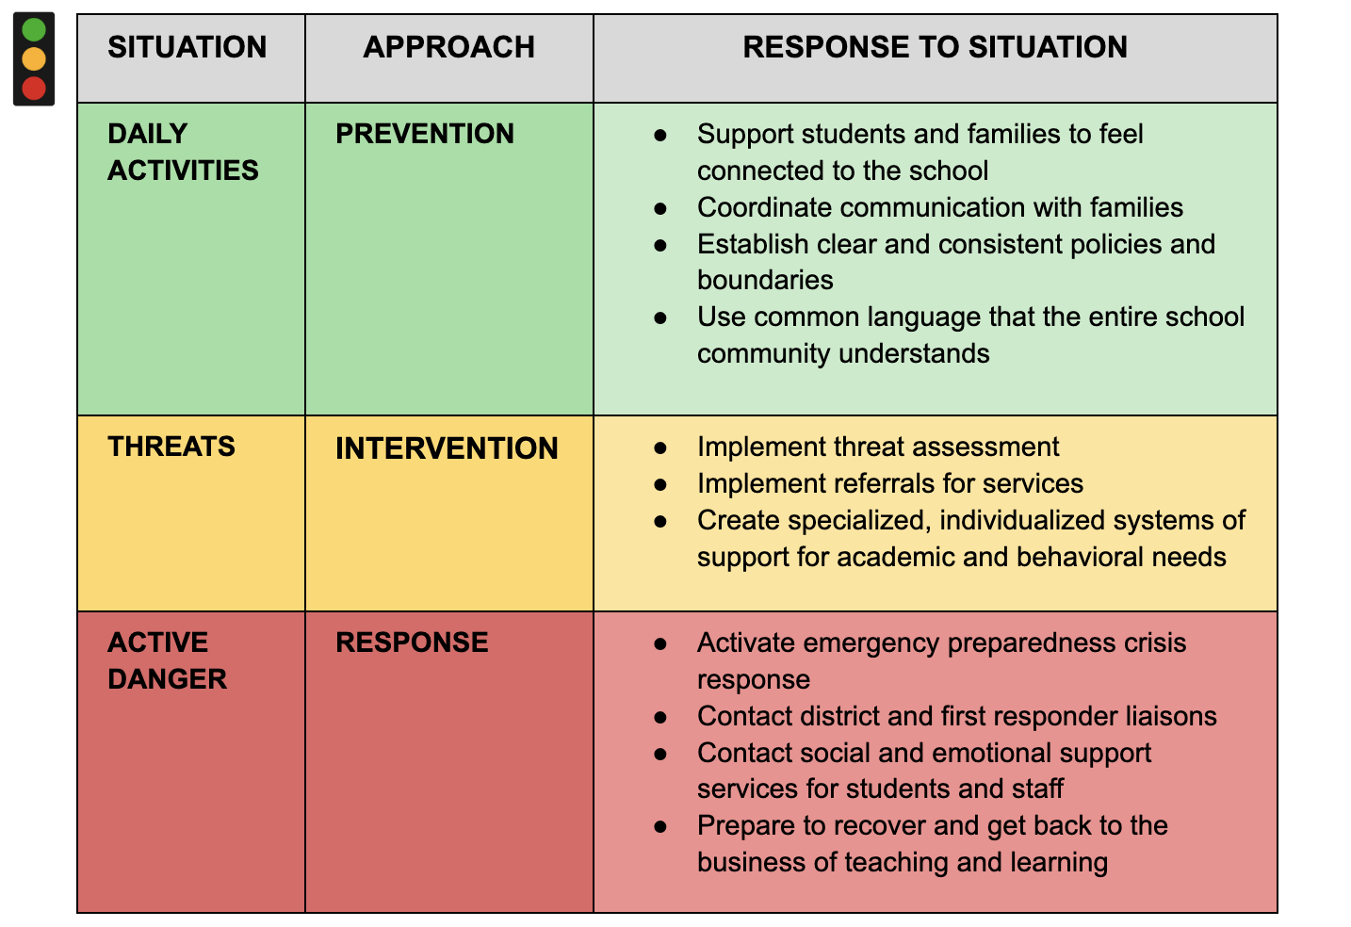
Notes:
The appropriate strategy depends on the situation.
Leaders need to be prepared to match the circumstances with strategies. Not every situation requires active shooter training. Leaders determine the strategies by assessing the situation. The vast majority of the time, the situation will be “school as usual.” So, a focus on a positive climate can forestall many more violent and dangerous events.
However, the everyday interactions between and among faculty, staff, administrators and students are powerful contributors to the kind of preventive climate there is in the school. If there is a threat to the normal operations of the school, then it is appropriate to implement intervention strategies If there is active danger, the response strategies are appropriate.
A comprehensive plan for school safety needs to have interventions at all three levels.
-------------------------------------------------------
Reflection or group discussion:
What activities, interventions are in place at this site in each of the categories?
What activities/interventions would be import to add?
-------------------------------------------------------
The next slide provides a definition of climate.

Slide 3

What is the climate in a school?
Climate is the quality of school life. It reflects the
Norms
Goals
Values
Relationships
Teaching practices
Discipline practices
Organizational structures
Notes:
School climate is a subjective concept. It can also be defined as the feel you get while in a school. This slide is meant to identify the qualities of a school climate.
-------------------------------------------------------
Reflection or discussion:
What are the components of an idea positive school climate?
What some ways in which faculty now are promoting a positive climate?
What areas of school climate are strengths at this school?
What would you like to see changed affecting the climate?
-------------------------------------------------------

Slide 4
What kind of climate increases safety in a school?
A Climate that
Supports students, staff and the community to feel connected to the school and participate in its major functions – teaching and learning.
Is free from threatening, violent or criminal behaviors
Safe
Connected
Notes:
The graphic show a circulars relationship that individuals who feel more connected to their school feel safer and feeling safer leads to a feeling of connectedness. Thus, having an impact on the major functions in a school which are teaching and learning.

Slide 5

What do students say makes a school safe?
When students behave and follow the rules
When I can participate in school activities without being made fun of
When I can talk to a trusted adult about safety problems or concerns
When I feel connected to teachers and other students
When students don’t fight or damage the school
Notes:
We interviewed middle school and high school students about what makes a school safe. They give insights into what structures need to be in place for safety such as clear rules and expectations, opportunities for meaningful school activities, teachers who are open to relationships with students, a discipline process that deals with bullying, harassment, and disruptive behavior.

Slide 6
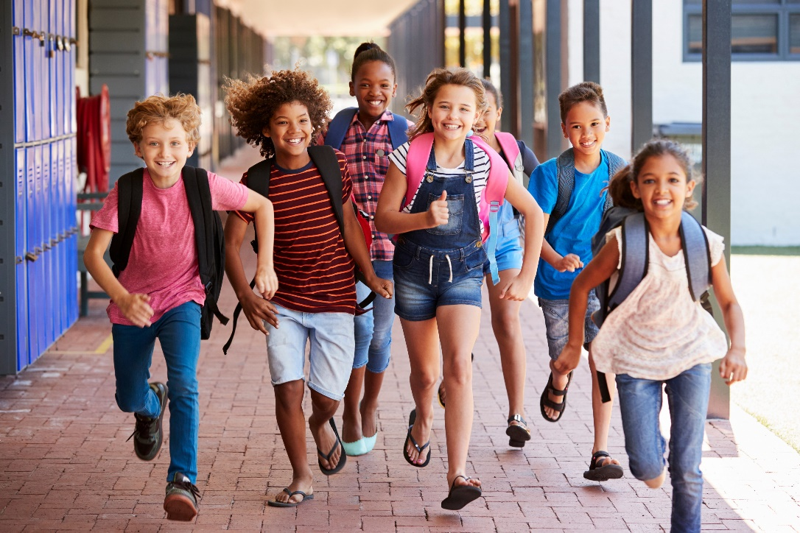
Why focus on climate as the foundation for safety?
Optional learning requires students to feel safe in their environment
Everyday actions in school can make a student feel safe or unsafe.
A negative climate can come from harassment, fights, substance use, rude or mean behavior.
Notes:
What is climate important in school safety?
School safety is complex and covers multiple concerns ranging from bullying and substance use to fighting and school attacks.
School safety is highly correlated with school climate. A more positive school climate equals a feeling of a safer school.
-------------------------------------------------------
Discussion/reflection Questions:
Ask if any of your staff have heard about promoting safe and supportive school climates.
How do your staff feel safe and supported at your school?
Do they think that the students feel safe?
-------------------------------------------------------

Slide 7

What are the benefits of a positive climate?
A positive climate is not a panacea but…..
Research has found that attending a school with a positive climate:
Decreases absences, suspensions, substance use, and bullying behaviors
Increases academic achievement, motivation to learn and psychological well-being
Notes:
A positive climate is a product of a school’s attention to
fostering safety
promoting feelings of connectedness
promoting a supportive academic, disciplinary, physical environment
encouraging respectful and trusting relationships throughout the school community.

Slide 8
What is the difference between a positive and negative climate?
Notes:
The climate of a school consists of many connecting parts and can range from positive and supportive to negative and toxic. This chart identifies some of the differences you can see in a positive climate versus a negative one.
Everyday actions of the adults in a school are critical to creating a positive climate. Leaders have the responsibility to oversee the climate by developing an infrastructure that grows and maintains a positive culture with intentionality.
Remind staff that
Through the development of a safe school a range of problematic behaviors can be addressed
School safety is highly correlated with school climate. A more positive school climate equals a feeling of a safer school
-------------------------------------------------------
Discussion/Reflection questions
From this list, what do you see as the strongest indicator that we have a positive climate? What is your evidence
From the list, which of the attributes of a negative climate do you think that this school has avoided? What do we need to do to make sure that we don’t have these things happen?
-------------------------------------------------------

Slide 9
What are some ways to support a healthy, positive climate?
School-wide programs or activities that promote healthy behaviors and reduce the likelihood of adverse and risky incidents.
Interventions universally applied to the entire school community
Multi-tiered Support Systems (MTSS) such as RTI or PBIS
Social-emotional learning (SEL)
Violence, bullying or substance use prevention curricula
Crime Prevention through Environmental Design (CPTED).
Notes:
Here are some group activities and resources that can foster a positive climate that encourages feelings of safety.

Slide 10
Reflective Questions
What did you learn today about safety and climate?
What is already working? What makes it work?
What can faculty and staff members provide to the conversation of school safety and climate?
What challenges might you face as you implement school safety and climate changes with faculty and staff members?
What agreements might need to be in place to ensure an equitable voice and participation with faculty and staff members?
So What? Now What?
Notes:
Here are some discussion/reflection questions. If time allows, implement a Think/Pair/ Share activity so that everyone has the opportunity to express their thoughts and feelings.
Understanding how climate is a critical part of our overall Comprehensive school safety planning, is the foundation for the work we will be doing to improve our climate.
Depending on the skills and knowledge level of your staff, you may want to plan to go through the power points on Climate and Academics, Family and Community relationship and/or Youth engagement and voice.
You can foreshadow the planning process, if appropriate.
First, we will establish a Leadership team consisting of faculty, staff and administration. If appropriate, selected students could serve on the committee or a sub committee of the larger group.
The Committee would be charged with :
- Conducting a Needs Assessment
- Identifying goals
- Reviewing and selecting a proven strategy or activity or curriculum
- Implementing the selected intervention
- Monitoring implementation
- Evaluating out comes,

