Slide 1
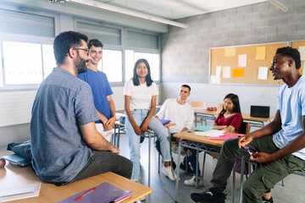

Listening and Engaging Students
Tapping into the power of youth voice
Notes:
The more students feel connected to their school, the less disruptive their behavior. The fewer disruptive incidents, the more positive the climate.
This power point provides the rationale for engaging youth to foster connectedness which leaders do a more positive climate and feelings of safety. It briefly outlines some of the research on youth involvement and voice and provides a model for implementing strategies that will increase the likelihood that all youth can participate in the ongoing functions of learning and socialization in the school.
The PowerPoint sessions on Safety and Climate and Academics and Climate provide further support for climate as an effective intervention supporting school safety, but also provide background for securing youth participation.
Discussion/reflection questions will be included in some slides to further deepen the learning and encourage critical thinking about how the concepts can be applied in their setting.

Slide 2
Student Connectedness
Students feel connected to school because they
  Have positive relationships with teachers and students
  Feel safe and are not victimized
  See what they are learning is important
  See students being treated fairly
  Feel that their opinions are listened to
Notes:
Students who feel that they belong in the school, are accepted or feel that they are connected in their school, have more commitment to education. They believe that school is important to their future and the adults in the school care about them and their goals. Keeping the school environment safe and engaging students in activities at their school enhances these feelings of connectedness.
High levels of school connectedness are a powerful predictor of a positive climate.
Discussion./Reflection questions in pairs, small groups or a general discussion:
Four of the questions involve the individual’s feelings. Seeing students being treated fairly is based their observations about how others are treated.
Why do you think this is an important component for safety and climate? (They see that others are not treated fairly and would like to be in a climate that is more equitable)
Which one of these items do you think we do well at this site?
Educators are doing one or more of these elements. The challenge is to assess the effectiveness and expand the activities to all students.

Slide 3
Why focus on engaging Youth?
Creating an environment in which all students feel that their voice is being heard has benefits to those students as well as the climate in both health and learning outcomes.
Notes:
Youth voice is defined as the ideas, opinions, attitudes, knowledge, and actions of young people.
Engaging youth voice is an essential element of effective organizational development among schools, community, and youth-serving organizations.
Asking youth their opinion about a topic does not mean that you will do everything youth suggests. It means that you have acknowledged their opinions and perspective and will take it them into consideration when making a decision.
Providing opportunities for youth to become more engaged in their school has numerous benefits to the school and to young people. Students can identify conditions that need changing. They can advocate for themselves and their peer and contribute valuable information in problem solving or decision-making processes.

Slide 4
How are youth viewed?
Objects - Adults know what is best for young people and see youth as the objects of their good intentions. Decisions are made without direct input from youth
Resources – Based on the respect for the unique contribution youth can make to improve the institution. Any leadership or decision-making roles can be shared by youth. Focus on creating partnership opportunities.
Notes:
Adults often need to change their view of youth within the organization. If you believe that students are objects and do not know what is best for them, Seeing youth as these objects stymies authentic engagement, because the adult believes adults know what is best for youth.
Changing the attitude to thinking of youth as resources in the change process opens doors for more conversations. Youth are the ones who know more about what is going on with students than adults do. They can provide insights at many levels.
When a program is in the planning stages, they can advise of how students might react. If there are problems with implementation, they can identify issues that a challenging for youth.
Youth are capable at all grades to express their opinions and offer suggestions. Their relationships with teachers and other students is strengthened when they feel that their ideas are solicited and paid attention to.
While not all programs or decisions are developed with youth partners but take every opportunity to include YOUTH VOICE from all groups of young people into consideration in decision making.

Slide 5
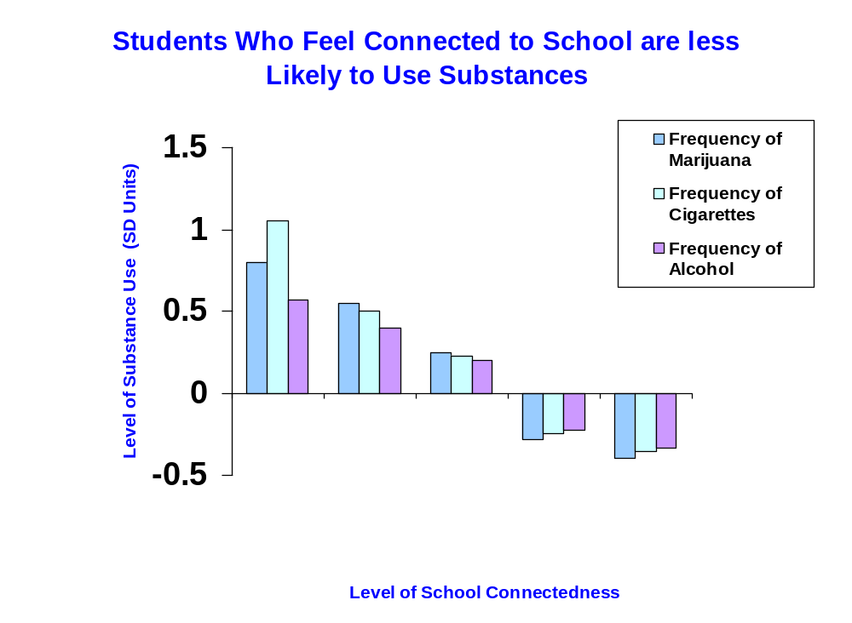
Adolescent Health Study
90,000 students
140 schools nationwide
7th-12th grade
Surveys and In home interviews
Followed into adulthood – Wave 4
*Add Health – McNealy, et al. (2002)
Notes:
The National Adolescent Health Study provides solid evidence of the relationship of connectedness to positive outcomes. For all three drugs, the more connected students feel to school, the less likely they will report using these drugs.
It is clear that drug use in teens impairs learning and positive youth development.
Please note these data are reported in Z scores. The Zero represents the average. A positive score above the average indicates more of the behavior than average and a negative score indicates less behavior than average. Note the pattern indicates that even some level of feeling connective is protective.

Slide 6
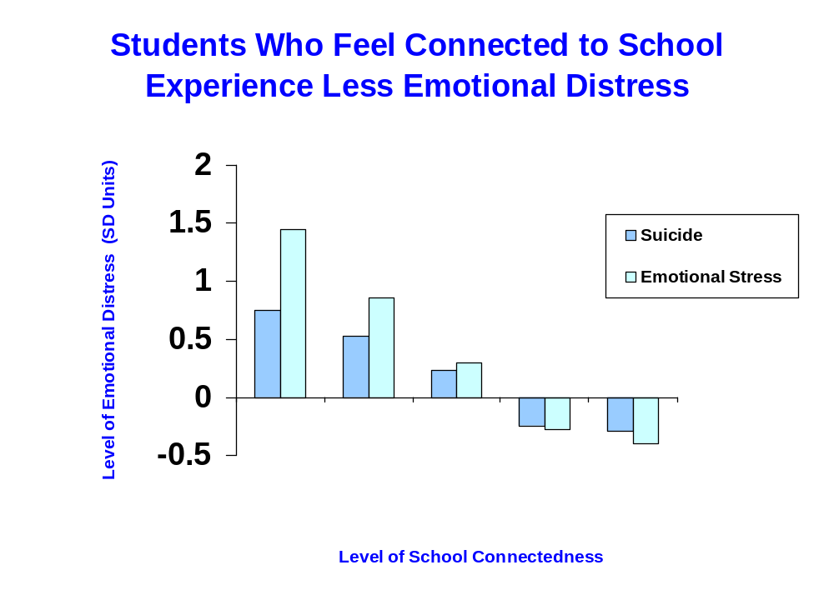
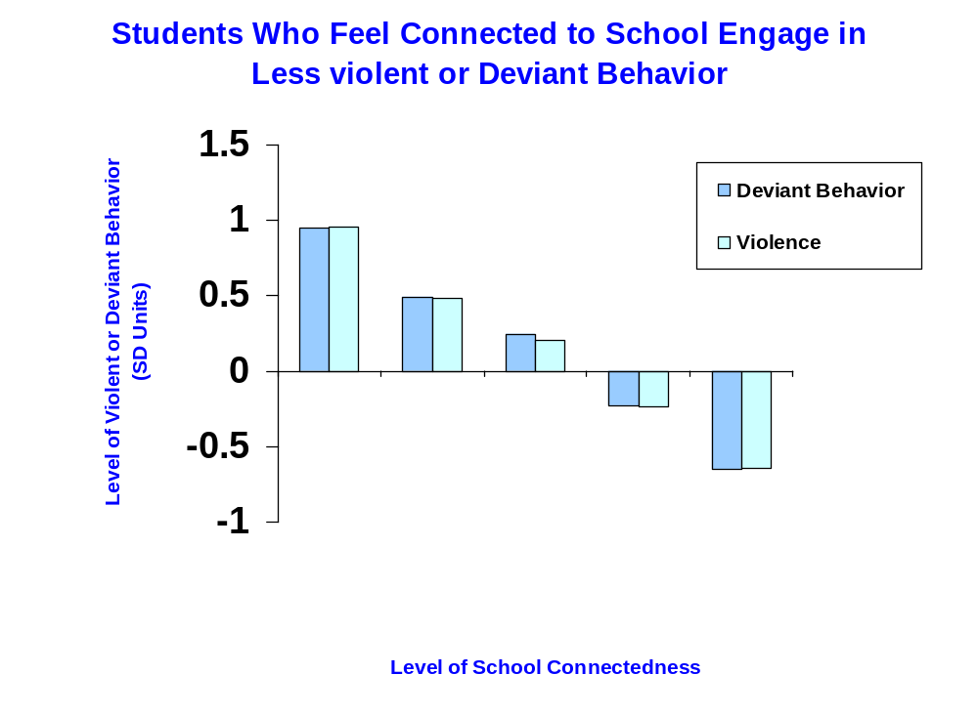
Adolescent Health Study
Notes:
The pattern we saw on the previous slide for drug use, is repeated for emotional distress and violent/deviant behavior.
The more connected the student feels the less adverse or negative behavior is reported.
The single strongest association with school connectedness is school was school climate.
Kids feel engaged when the environment is seen as a safe place: physically, emotionally, and intellectually/academically-no ridicule for taking academic risks; not made to feel like a failure.

Slide 7
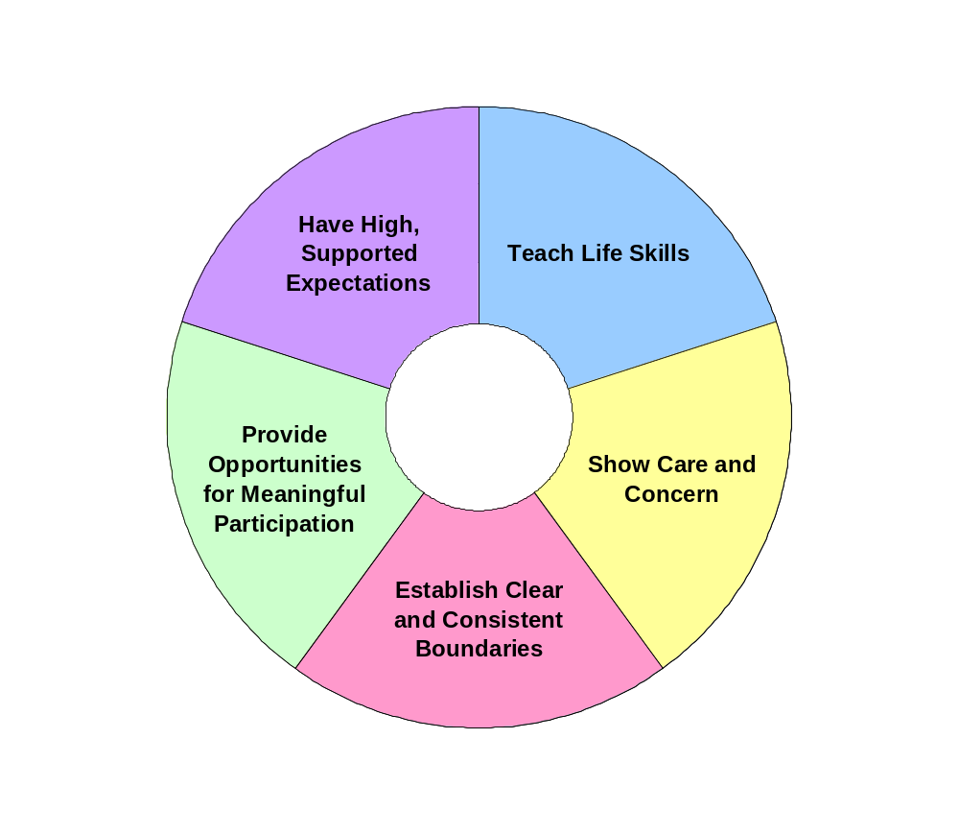
Practical Approaches to supporting CONNECTEDNESS and YOUTH VOICE
Bonding
Connectedness
Notes:
Through research on the activities that support resiliency and connectedness, Nan Henderson identified five activities that support students, promote students’ voices and lead to increased connectedness and a sense of belonging.
The Resiliency wheel provides some strategies to increase opportunities for youth connectedness, build resiliency in the environment and mitigate risk factors.
Keeping the school environment safe and engaging students in activities at their school enhances the feelings of CONNECTEDNESS.
The next slides will discuss each slice of the pie and provide some strategies.

Slide 8
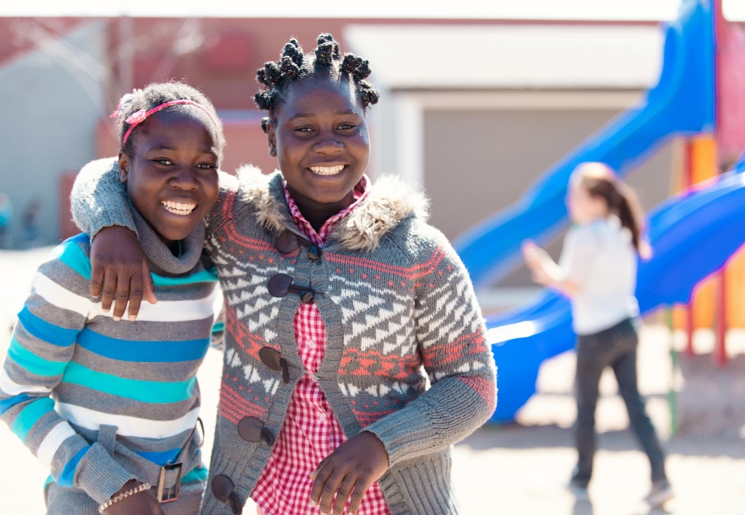
Show Care and Concern
Relationships are the foundation of a positive climate.
Learn and use student names in positive situations
Treat others the way you would want to be treated.
Be polite – say please, thank you, you are welcome.
Find time each day to give attention and emotional support to students and colleagues.
Notes:
All members of the school community show care and concern toward one another.
Your everyday interactions with students and colleagues are the foundation of a positive environment. Do not discount the power of little things done on a regular basis such as using someone’s name, remembering a positive thing that they have done, saying please, thank you, and your welcome.
Reflection/Discussion:
Observe how many times you use someone’s name without a reprimand or polite words.
What are some ways people at this school could show more care and concern?
Among your colleagues, who are good at building relationships? How do they do this?

Slide 9
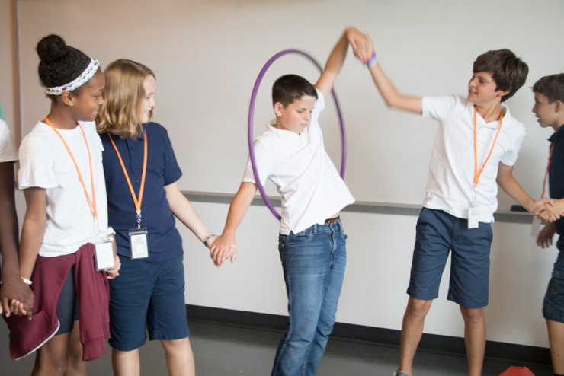
Establish Clear and Consistent Boundaries
Involve all members of the school community, especially young people.
Acknowledge appropriate or caring behaviors
Notes:
Even elementary students can have an opinion about what the rules should be.
In one elementary school, students made a list of 20 possible rules or behavioral expectations. Every student had the chance to vote for their top 5. The school climate team then selected the ones for the rest of the year. Positive Behavioral Interventions and Supports (PBIS) has a process for identifying and teaching behavioral expectations.
Rules and expectations should be posted throughout the school and students should be reminded of them regularly. Staff need to review discipline records to ensure that they are applied consistently and fairly.
Discussion/Reflection:
How can staff acknowledge appropriate behaviors without seeming as you are bribing students?
Why is it important to teach students rules and procedures?

Slide 10


Provide Opportunities for Meaningful Participation
Listen to students’ ideas and opinions
Be sensitive to cultural differences
Create time for students to actively participate
Provide a range of clubs and activities to meet the interests of different groups of students
Notes:
Students can provide input to the school structure and generate ideas about activities they would be interested in participating.
A principal’s advisory council can be a sounding board for new ideas in the school.
Service-learning projects connect students to their interests in the community.
Reflection/Discussion:
How many different types of musical groups could you imagine at your school?
Who in the community (including parents) could volunteer to share expertise with students?
How could you engage local colleges or universities in project?

Slide 11

Have High, Supported Expectations
Create realistic expectations to motivate students
Create collaborative and interest-based learning opportunities
Provide tutoring or other appropriate support
Notes:
Engage students in helping others, problem solving, and planning activities.
High expectations are a driver of student achievement. High expectations need to be accompanied with support that is sensitive to individual differences and skill levels.

Slide 12

Teach Life Skills
Identify age-appropriate skills necessary to successfully navigate life
Use a Social-Emotional Learning approach to navigate challenges
Teach conflict resolution and cooperation skills
Notes:
Teaching life skills are necessary to manage emotions, achieve positive goals, and show empathy for others.
As students work in groups, group skills such as cooperation, listening, and organization can be reinforced in addition to teaching skills using an evidence-based curriculum.
Link social and work-related skills with behavioral expectations and procedures.
Acknowledge social skills competence and progress towards meeting goals.

Slide 13
Some ideas for youth participation opportunities
Student lead Parent/teacher conferences
Buddy systems
Class meetings
Peer mediation
Teen courts
Teen Town Hall
Youth Advisory Councils/Principal Advisory Groups
Youth Participatory Action Research (YPAR)
Notes:
Here are some ideas on how to engage students in the school organization and activities.
Reflection/Discussion
Which one of these activities do see as having the most impact with your students?
Which one would you be most comfortable leading?

Slide 14
Adults can build Youth Voice by…
Listening to young people and be willing to learn from them.
Providing young people with the information, training and support they need to succeed.
Planning meetings where everyone feels welcome.
Involving young people in the decision-making from the very beginning (before its too late for them to be a part of meaningful change).
Including as many young people from different groups as possible.
Notes:
Here are some ideas on how adults can build youth voice in the school organization.
Reflection/Discussion
Which one of these activities do see as having the most impact in your school organization?
Which one would you be most comfortable leading?

Slide 15
Reflective Questions
What did you learn today about Youth Voice?
What is already working? What makes it work?
What challenges might you face as you implement school safety and climate changes with students?
What might you need to prevent or overcome those challenges?
What agreements might need to be in place to provide safe/brave spaces to ensure an equitable voice and participation with students in the conversation of school safety and climate?
So What? Now What?
Notes:
Questions to consider and discuss either in pairs, small groups or as a large group discussion.

