Slide 1

How Does School Climate Affect Academics?
Academics and climate

Slide 2
What is An Optimal Learning Environment?
All students can achieve academically given the right conditions and supports.
As educators, we can control 3 essential components for optimal learning. Each of which plays a necessary role in student learning:
Curriculum
Instruction
Climate
Notes:
An optimal learning environment reflects a belief that all students can achieve high standards. This can be accomplished when all three areas are addressed. These three systems (areas) are curriculum, instruction and climate. For optimal learning to occur three systems (areas) MUST be not only present but working together.

Slide 3

What are the Essential Components?
Curriculum
Instruction
Climate
Each of these elements plays a
role in student learning.
Notes:
The diagram is a visual description of how these three areas of learning environments come together to create a sweet spot where optimal learning can occur. However, this only occurs when all three system areas are working together.
You can have the best evidence-based curriculum but if there is poor instruction learning will not be optimal. Nor will learning be optimal with the most skilled teachers in instruction if there is a weak curriculum. Furthermore, even with a great curriculum and skilled teachers if children are afraid to come to school or feel unsupported then learning is suppressed and does not allow for optimal learning to occur.

Slide 4
How Do Curriculum, Instruction, and Climate Work Together for Learning?
A strong CURRICULUM has been evaluated to ensure that the content and the scope and sequence provide clear explanations, build on past learning, and have interactive activities.
The curriculum has integrated into the relevant subjects the stories of different racial and ethnic groups.
---------------------------------------------------------------------------------------------
Students do not get the full power of the curriculum unless the INSTRUCTION is strong and engaging.
Teachers must first be well-versed and current in their content area. They must be well-versed in the neuro-science of learning and have the skills to provide interactive instruction that engages all learners
Next, let’s look at CLIMATE.
:
Notes:
A strong curriculum working in unison with the other system areas should have agreed upon guidelines and builds on past learning thus ensuring students are progressing and allowing teachers to ensure students are understanding what is being taught. It should also include a variety of learning modalities as not every student learns the same.
A strong instruction system area needs to include teachers who are skilled in instruction and knowledgeable in the subject they are teaching. It is difficult to teach and answer questions about something you don’t fully understand yourself. Keeping students engaged is also needed this can be done through interactive learning strategies this also aides the student in retaining the information.
Interactive learning strategies can include:
Ask for feedback, let people choose the way, make it social, invite learners to contribute, encourage peer evaluation
Brainstorming, think-pair-share, buzz session, incident process, Q&A.
However, we still have one more system area that is needed for optimal learning to occur.

Slide 5
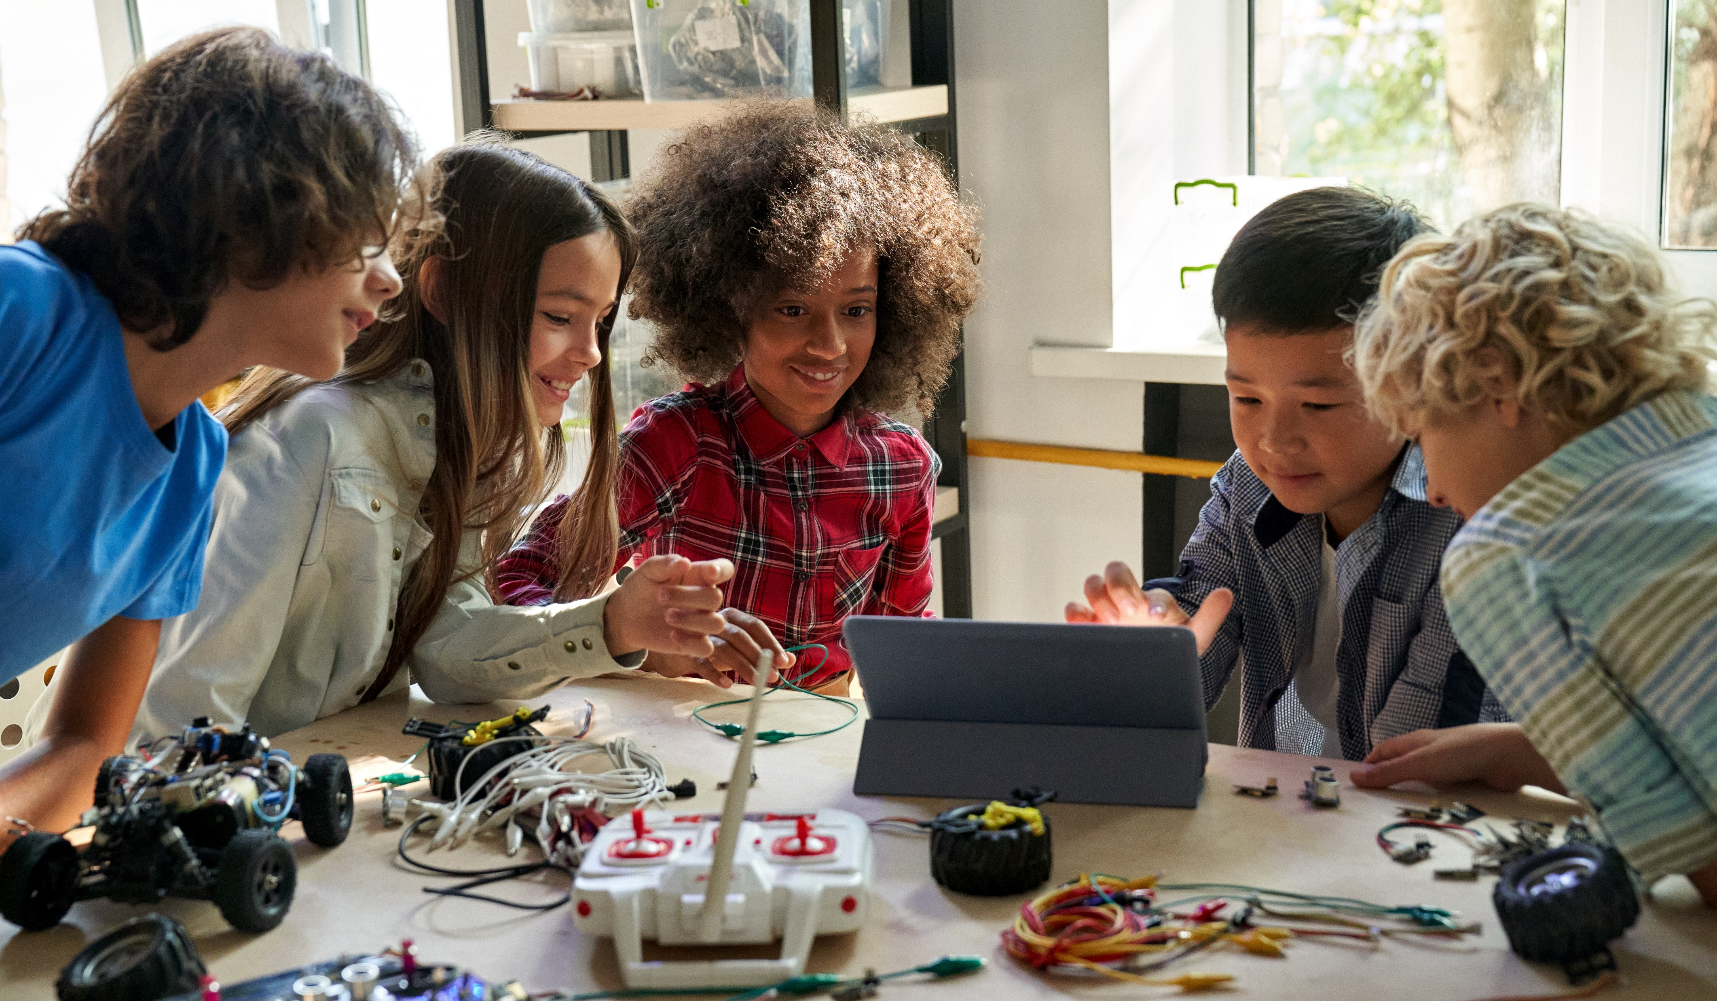
Where Does Climate Fit?
Even with a strong curriculum and skilled teachers, optimal learning also needs a positive climate in the school and the classroom.
Students are less able to learn if the climate is threatening, unwelcoming or disorganized.
Notes:
School Climate is just as critical as the other areas for optimal learning to occur. School climate will be further explained and examined in the next slide(s).

Slide 6
What are the components of A School Climate That Supports Learning?
Neuroscience defines the optimal learning climate is high in challenge to engage students in active learning and low in threat such that students feel safe.
Students need to feel safe emotionally, academically and socially.
Notes:
The National School Climate Center provides an explanation of school climate:
The quality and character of school life. School climate is based on patterns of students', parents' and school personnel's experience of school life and reflects norms, goals, values, interpersonal relationships, teaching and learning practices, and organizational structures.
We can see that it is based on multiple different groups perceptions and experiences of school which are influenced by both relationships, learning experiences, and organizational factors.

Slide 7
What are the Ways Students Feel Safe?
In emotionally safe climates, students feel they can be open and vulnerable without fear of disapproval or ridicule.
In socially safe climates, students feel secure, cared for, and trusted, and not afraid of being abandoned or misjudged.
In academically safe climates, students are not worried about making mistakes and can freely express their opinions and ideas.
These three factors create a safe school climate!
Notes:
If individuals do not feel safe it is difficult to be truly engaged in learning. Students are encouraged to use “mistakes” as learning opportunities and supported in their academic pursuits.

Slide 8
Students are Safe
  Physically
  Emotionally
  Socially
  Academically
  School is organized
Students are Supported
  Students feel adults care equally about their academics and well-being
  Effective and available support
  Positive peer relationships
Safe School Climate
Students are Socially Skilled
  Competent and sensitive both emotionally and culturally
  Contributors to school and community
  Responsible
  Cooperative
Students are Challenged
  Academic opportunities
  High expectations
  Student motivation is encouraged
  School both support and is a part of life goals
Notes:
Model of areas mentioned previously in a safe school climate further explained. Transitions are used to only bring up one area at a time in order to focus discussions.

Slide 9
What Are The Benefits of a Safe Climate?
In a safe climate Social Justice Reigns
  All students are treated with respect
  Differences in background and ethnicity are considered a strength
  All voices are heard
  All individuals have access to opportunities, privileges, and responsibilities
All in the school environment are committed to forming positive relationships
  Administrators relate well to parents, teachers, and students
All individuals feel connected to the school environment
Notes:
Discussion: In a social just climate previous injustices are acknowledged and mediated, and curricula is expanded to include cultures represented within the school and globally. Allowing everyone to feel recognized and respected. Emphasizing the uniqueness of each individual and the strengths they bring to your community.

Slide 10

What Does All This Mean?
Curriculum, Instruction, and Climate work together to create both a safe and optimal learning environment.
This trio creates a space where students feel emotionally, socially, and academically safe.
This environment fosters social justice, positive relationships and connections to the school.
Notes:
Important to note for principals and other administrators that leadership is essential in orchestrating the interplay amongst these areas (curriculum, instruction, and climate).

Slide 11
Reflective Questions
What did you learn today about academics and climate?
What is already working? What makes it work?
What challenges might you face as you implement academic and climate changes with faculty and staff members?
What might you need to prevent or overcome those challenges?
What agreements might need to be in place to provide safe/brave spaces for more challenging conversations?
So What? Now What?
Notes:
Questions to consider and discuss.

