Slide 1
Building the Capacity in Schools for
Prevention & Safety
Kris Bosworth, Ph.D.
Professor & Smith Endowed Chair in Prevention and Education
Education Leadership and Policy (EDLP)
College of Education
University of Arizona

Slide 2

Begin with the end in mind…..
Keeping students safe in schools is multidimensional, involves numerous scenarios, and several levels of expertise and training.
Optimal safety includes being free from harassment and bullying, substance use and sales, adverse childhood experiences, discrimination and macroaggressions, assault, theft and other criminal activity.
Lessons learned and research findings from Prevention Science guide activities to promote safety in schools

Slide 3
How I began this journey
Middle school social studies teacher
Educator working in a day treatment program for adjudicated teens
At the University of Wisconsin-Madison in 1970-80’s, research scientist developing computer-based prevention interventions for teens with Kellogg Foundation & NIDA grants.
At Indiana University developed the Center for Adolescent Studies and CDC grant for computer-based teen violence prevention
Research scientist with the new CDC Youth Violence Prevention Team
Appointed Smith Endowed Chair at University of Arizona and changed focus to school climate interventions

Slide 4
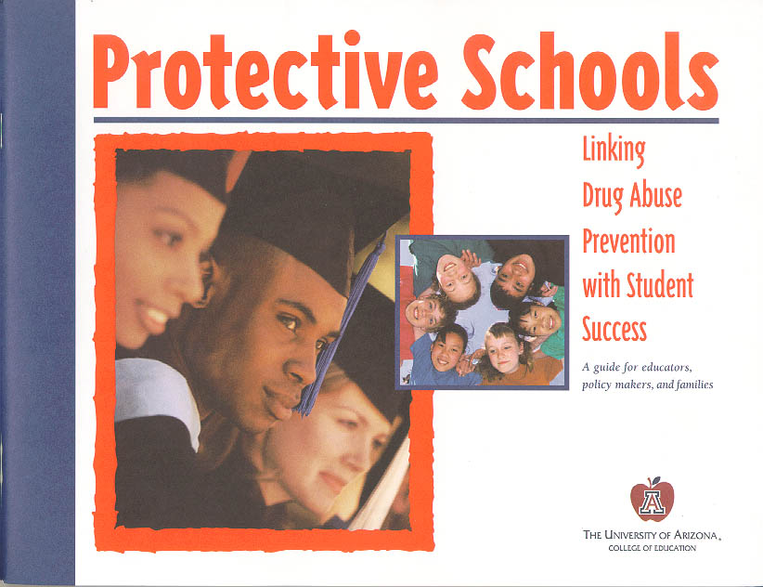
Insert photo of book cover

Slide 5
Protective Schools Approach
A protective school provides an environment that is a buffer or safety net against risk factors or adverse events.

Slide 6
10 Protective Schools Factors
Vision
Positive culture
Leadership commitment
Strong academic programs
Research-based prevention
Continuum of services
Professional development
Home-School-Community relationships
Funding and resources
Data-based decision making

Slide 7
Model Refinement
Grants from
  US Department of Education
  SAMSHA
  National Institute of Justice
  CDC
  Arizona Department of Education
Implemented the Protective Schools Model in over 100 traditional and charter K-12 schools

Slide 8
UNIVERSAL SCHOOL-BASED PREVENTION/SAFETY COMPONENTS
School policy
School climate
Prevention curriculum/programs

Slide 9
Why School Policy?
First step in a comprehensive prevention approach for schools.
Give clear direction to students, parents, staff and administration.
Must be enforced to have an impact.
Some evidence of effectiveness in reducing amount of behavior but often not prevalence.

Slide 10
What Principals say
It is important that the adults have a set of policies and procedures in place which are implemented consistently and fairly.
J.C., Associate Superintendent
Strong policies offer guidance in the school community as to what is tolerated and what is not.
C.C., High School Principal

Slide 11
Why School Climate?
The quality and character of life in a school
Reflects the norms, values, relationships, interactions, organization and processes
Sets the tone for all teaching and learning – formal and informal curriculum
Critical to student connectedness
The greater the connectedness, the less substance use and disruptive behavior

Slide 12
What Principals Say…
School climate is the feeling you get when you walk on campus of positive and respectful behaviors, mutual respect between adults and kids, happy people.
T.C.V. – Middle School Principal

Slide 13
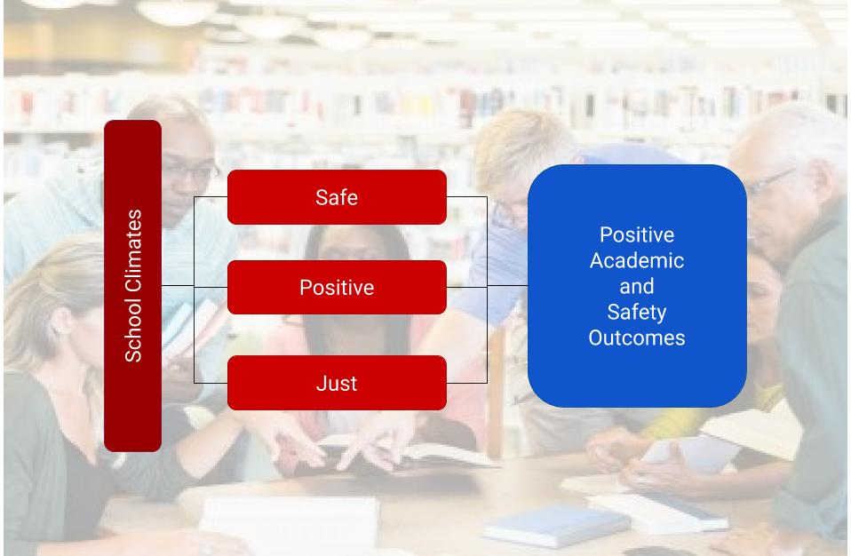

Slide 14
School climate
Student Connectedness
Outcomes
Notes:
Say: This is how this dynamic works. The school climate leads to a greater or lesser degree of student connectedness. Greater of lesser degree of student connectedness leads to outcomes that are either positive or negative, and so we as educators and prevention specialists are gong to focus on the role of school climate in engaging students and helping them to feel more connected to school. The result of that interaction will be better health outcomes, including less drug abuse.
Pair share on how this mechanism works at their site.

Slide 15
Why Prevention Evidence-based Curriculum/Programs?
Demonstrated effectiveness through balanced, objective research rather than anecdotes
Most likely to produce the desired result
Developed based on theory of change
Concentrate limited resources on proven programs
Educators can focus on delivery rather than development
Garner support from parents, community and potential funders

Slide 16
What principals say
With XXXX (name of a curriculum), I feel confident that our students will get the information they need to make good choices. The evidence is really strong.
F.A.H., High School Principal

Slide 17
CLIMATE & ACADEMICS

Slide 18
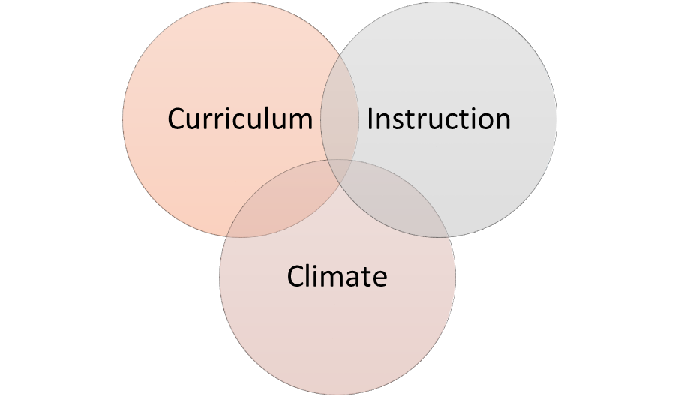
Role of Climate in
Optimal Learning
Optimal learning includes all three areas
Notes:
Describe what Optimal learning is. An optimal learning environment reflects a belief that all students can achieve high standards. This can be accomplished when all three areas are addressed.
Diagram is a visual description of how these three areas of learning environments come together to create a sweet spot where optimal learning is able to occur but only once all three system areas are working together.

Slide 19
CLIMATE & SAFETY

Slide 20
What Makes a School Safe?
Free from threats, violence, or other criminal behaviors.
Allows staff, students, and the community to feel connected to the school and able to participate in its major functions – teaching and learning.
Safe
Connected
Notes:
This slide is again meant to provide some background information.
This is how the 2020 initiative of school safety and climate is defining a safe school as.
The graphic is meant to show a circular relationship that individuals who feel more connected to their school feel more safe and feeling more safe leads to a feeling of more connectedness. Thus having an impact on the major functions in a school which are teaching and learning.

Slide 21
If kids love their school they do not want to disrespect their school or let down the adults they care about. They also will be more likely to report things before they get too big or result in violence.
B.R.R. – Middle School Principal

Slide 22

Secret Service Studies of School Shootings - 2002 & 2019 Findings
Lack of an accurate profile for the type of school or student involved in shootings
Most attacks ended very quickly, law enforcement rarely had the opportunity to intervene before serious harm was caused

Slide 23
Recommendations
Create and promote safe school climates and student connectedness such that students trust adults to protect them
Schools need to establish comprehensive targeted violence prevention programs.

Slide 24
Connectedness
A sense of being cared for, recognized, supported and belonging

Slide 25
Connectedness Operationized
  Feel close to people at school
  Happy to be at school
  Am a part of this school
  Students are treated fairly
  Feel safe

Slide 26
Adolescent Health Study*
90,000 students
140 schools nationwide
7th-12th grade
Surveys and In home interviews
Followed into adulthood – Wave 4
*Add Health – McNealy, et al. (2002)

Slide 27
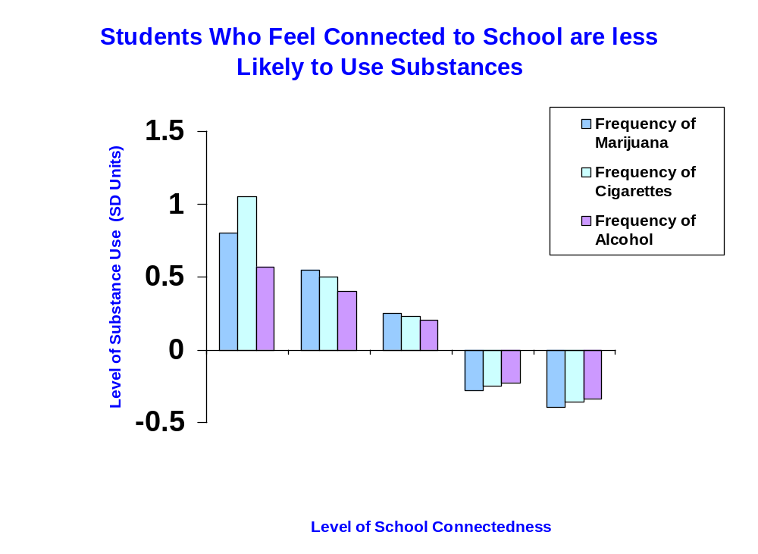
0 1 2 3 4
Not at All Very Somewhat Quite Very
Connected Little A Bit Connected

Slide 28
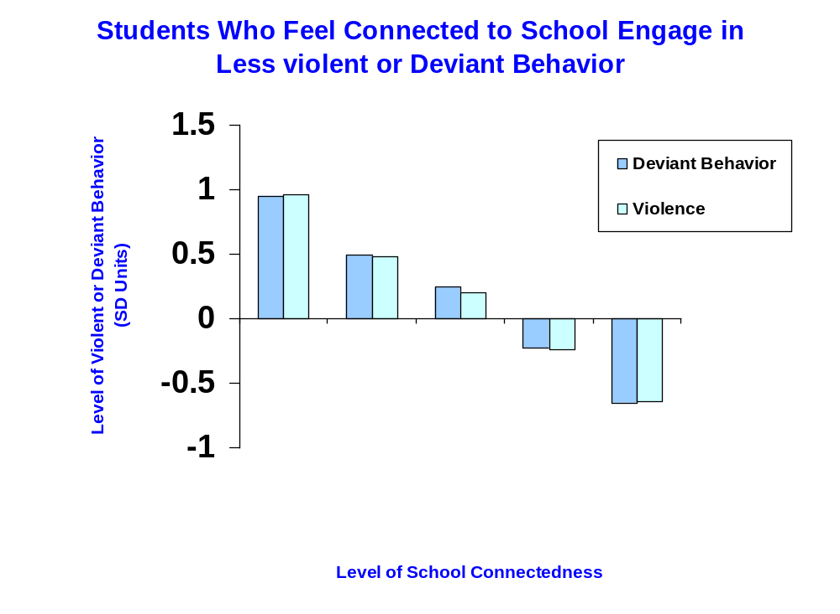
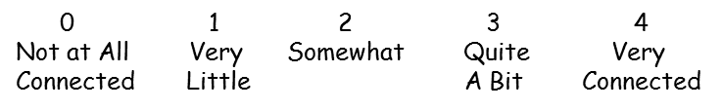

Slide 29
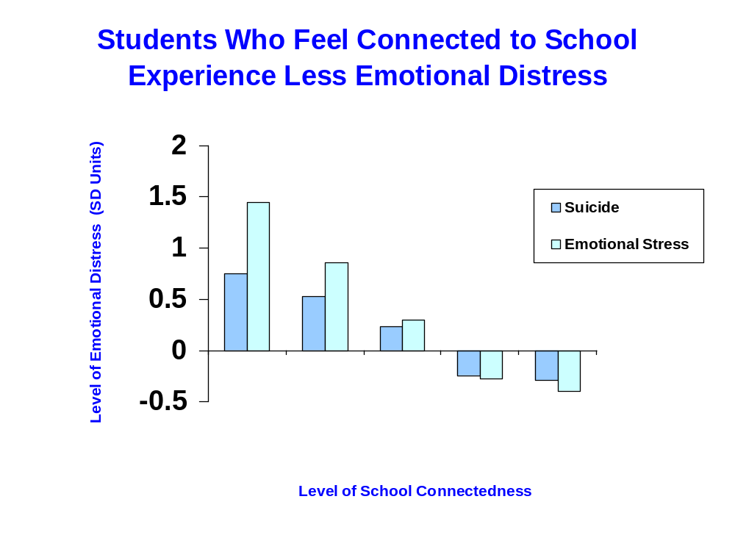
0 1 2 3 4
Not at All Very Somewhat Quite Very
Connected Little A Bit Connected

Slide 30
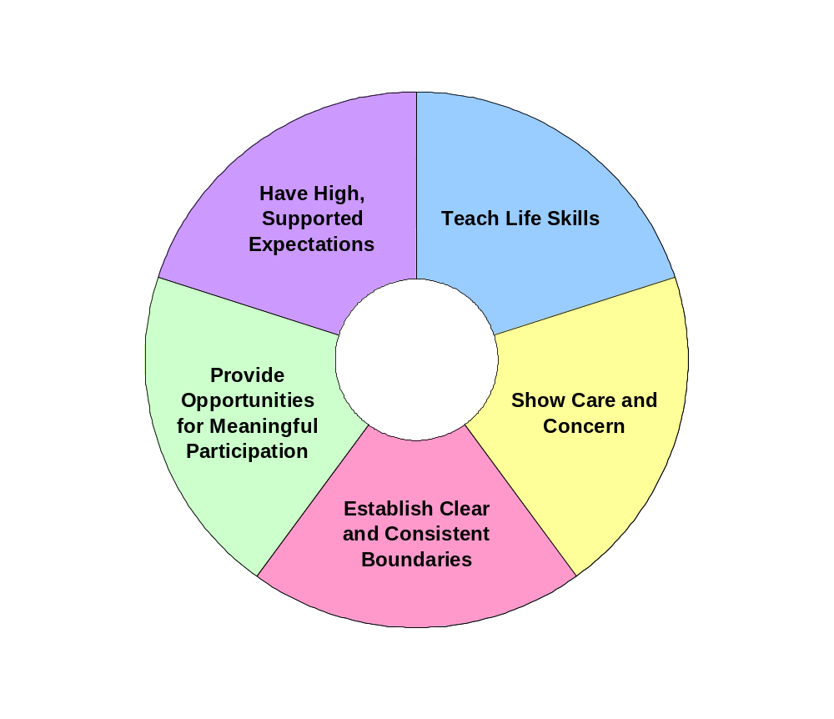
Bonding/
Connectedness
30
Notes:
30

Slide 31
SPECTRUM OF SAFETY
INTERVENTIONS/STRATEGIES

Slide 32
Spectrum of School Safety Strategies/Interventions
Because of the range and complexity of issues and responsibilities encompassed in school safety issues
A spectrum of strategies must be considered to address school safety.
Prevention
Intervention
Response
Spectrum of school safety
Notes:
What is school safety?
School safety is complex, and covers multiple concerns ranging from bullying and substance use to fighting and school attacks.
School safety is highly correlated with school climate. A more positive school climate equals a feeling of a safer school.
Discussion Question: Ask if any of your staff have heard about promoting safe and supportive school climates. Do your staff feel safe and supported at your school? Do they think that the students feel safe?

Slide 33

School Safety Spectrum
Prevention: includes schoolwide strategies that promote healthy behaviors and reduce the likelihood of adverse behaviors and incidents. For example…….
  Positive and supportive school climate
  Evidence-based curriculum
  Engaging youth
Notes:
Go through the three areas of the spectrum in detail more here with your staff.
The key point from this graphic is to show that all these areas (prevention, intervention, and response) are encompassed in the school safety spectrum it is not just one area dominant. All areas are needed in the development of a safer school and climate.

Slide 34
School Safety Spectrum
Intervention: includes strategies that identify and support students with risk factors or signs of problematic behaviors. For example…..
  a threat assessment protocol
Response: includes an effective response plan that can be implemented when an incident of violence or potential harm has occurred. For example…
  Emergency response plan,
  Emergency preparedness
  Crisis counseling/aftercare
Notes:
Go through the three areas of the spectrum in detail more here with your staff.
The key point from this graphic is to show that all these areas (prevention, intervention, and response) are encompassed in the school safety spectrum it is not just one area dominant. All areas are needed in the development of a safer school and climate.

Slide 35
Comprehensive School Safety Plan Includes:
    Infrastructure to support
      Prevention
      Intervention
      Response

Slide 36
Infrastructure
Teams
  School Safety Team
  Threat Assessment Team
Data for decision making
  Internal
  External
Staff professional development – for example
  Emergency response plan
  Bullying
  Suicide
Liaison
  District
  Community

Slide 37
Building Teams for School Climate, Safety & Prevention
The basic organizational structure for developing and continuing a comprehensive school-based climate, safety and prevention program is creating a
Leadership TEAM.

Slide 38
Building Teams for School Climate, Safety & Prevention
Team responsibilities include:
Developing policies
Meeting regularly
Collecting & and analyzing data
Planning evidence-based interventions
Monitoring progress
Communicating with stakeholders

Slide 39
Creating School Policies
Using the newly created team, administrators with the Team need to:
  Evaluate current policies
  Lead a process to update or create polices that will reflect research-based practices or published standards such as: the International Standards on Drug Use Prevention.
  Integrate policies into life of the school

Slide 40
Prevention
Creating, communicating and enforcing policy
Climate interventions
  Multi Tiered Support Systems (MTSS)
  CPTED from CDC
Youth voice
Social justice approaches
Student Curriculum - for example
  Social Emotional Learning
  Law related education
  Bullying prevention

Slide 41
Intervention
Campus security
Behavioral and mental health services
Restorative Practices
Alternative to exclusionary practices
MTSS -Tier 2 & 3 Intervention/Referrals
Threat Assessment Protocol
  Human threats
  Cyber threats

Slide 42
Response
Emergency Operations/Response Plan
Critical Incident coordination
Crisis counseling
Aftercare

Slide 43
Evidence from Safe Schools/Healthy Students grant – 55 secondary schools
90% - reduction in referrals for student aggression
90% - reduction in fights on campus
73% - reduction in suspensions
80% - reduction in graffiti or tagging
92% - reduction in student reported 30 day alcohol use
96% - reduction in students reporting being offered, sold or given illegal substances on campus

Slide 44
Developing a Comprehensive Plan
Build on existing school assets and organization
View as a process in a 3-5 year timeframe
Continuous improvement process
Visionary leadership
Faculty and Staff buy-in

Slide 45
Developing a Comprehensive Plan
Create infrastructure including a School Safety and Climate Team
Assess climate from the perspective of students, faculty, and parents
Identify realistic goals for improvement
Develop an action plan to meet goals
Continuous cycle of improvements
Develop Threat Assessment Protocol and Emergency Response Plan
Train relevant staff on each activity

Slide 46
Comprehensive School Safety Plan
CHECKLIST
Educational tool
Planning tool
Needs assessment tool
Evaluation tool

Slide 47
Contact information
Kris Bosworth, Ph.D.
Professor and Interim Director
Educational Leadership and Policy Program
Smith Endowed Chair I Prevention and Education
College of Education
University of Arizona
Tucson, AZ 85721

Slide 48
RESOURCES
Bosworth, K. Editor. (2015). Prevention Science in School Settings: Complex Relationships and Processes. New York: Springer.
McNeely, Nonnemaker, & Blum. (2002) Promoting school connectedness: Evidence from the National Longitudinal Study of Adolescent Health. Journal of School Health 72(4).
Protecting America’s Schools: A U.S. Secret Service Analysis of Targeted School Violence https://www.secretservice.gov/data/protection/ntac/USSS_NTAC_Enhancing_School_Safety_Guide_7.11.18.pdf

Slide 49
Questions and Discussion

